Slide 1
Memory-efficient data structures
universal / perfect hashing

Slide 2

Querying using hash table

Slide 3
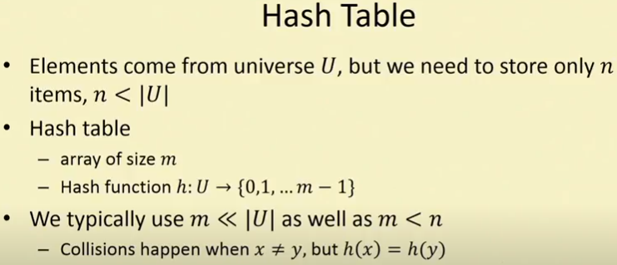
Collision occurs because of pigeon hole principle.

Slide 4
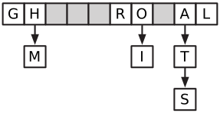
Chaining
One of the most common methods for resolving collisions in hash tables is called chaining. In a chained hash table, each entry T[i] is not just a single item, but rather (a pointer to) a linked list of all the items that hash to T[i] .

Slide 5

One property of ideal random hash functions that seems intuitively useful is uniformity . A family H of hash functions is uniform if choosing a hash function uniformly at random from H makes every hash value equally likely for every item in the universe:

Slide 6

Universal hash function
A much more important goal is to minimize the number of collisions. A family of hash functions is universal if, for any two items in the universe, the probability of collision is as small as possible:

Slide 7
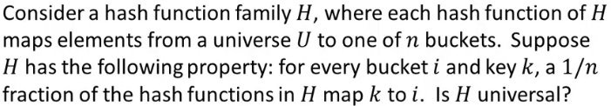

Slide 8
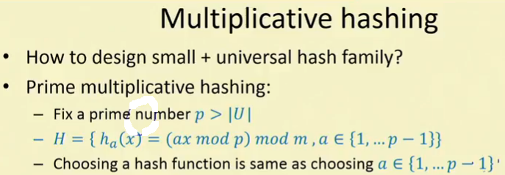
How to create Universal Hash family
m is the size of array

Slide 9
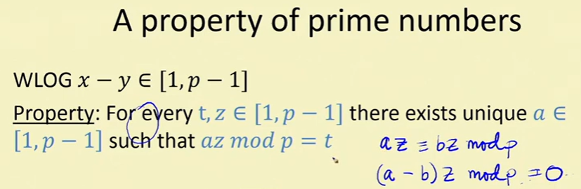

Slide 10
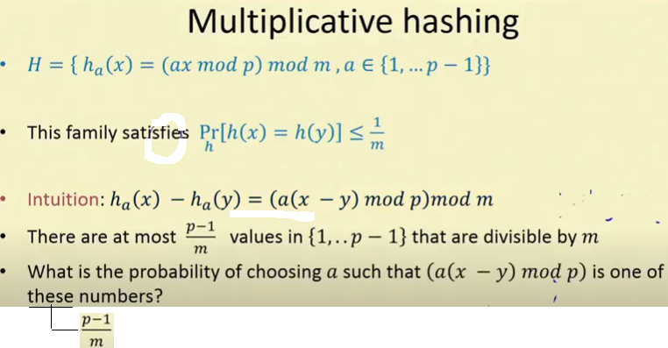

Slide 11
Let m = 7 and p = 23
ha(x) - ha(y) = [a(x-y) mod p] mod m
ha(x) - ha(y) = 0 implies that Square bracket is completely divisible by m and > m
Therefore possible values of Square bracket = 7,14,21,28,........
But p = 23
Therefore possible values of Square bracket = 7,14,21 only.
If I choose a = 7,14,21 there will be collision. We have to prove that probability of this event is < 1/m

Slide 12
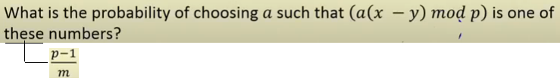

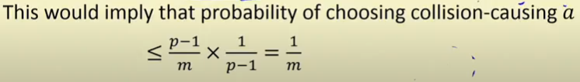
Irrespective of values of x and y, by the property of prime numbers,
we can say there is unique a among numbers. If we choose this a then there will be a collision.

Slide 13
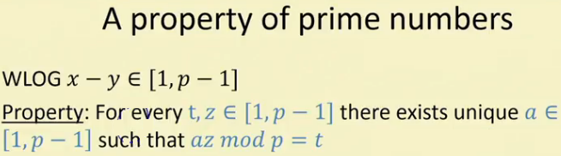
Proof :
Assume a is not unique. Therefore there exists b<>a
az mod p = bz mod p
(a-b)z mod p = 0 ……… (a-b) and z both are less than p. Hence this is true only if a=b. Therefore a is unique. Hence Proved.

Slide 14
Let x > y
P > |U| therefore (x - y) belongs to [1,P-1]
How many ways of choosing a from (p-1)/m
Since (x - y) belongs to [1,P-1], there are maximum (p-1) numbers.

